Slide 1



Tenant Insight & Satisfaction Surveys Roundtable
Arolygon Mewnwelediad a Bodlonrwydd Tenantiaid
Thank you to our sponsor:
Diolch i ein noddwr:

Slide 2
Welcome / Croeso
Feel free to introduce yourself by putting your name and organisation in the chat

Slide 3
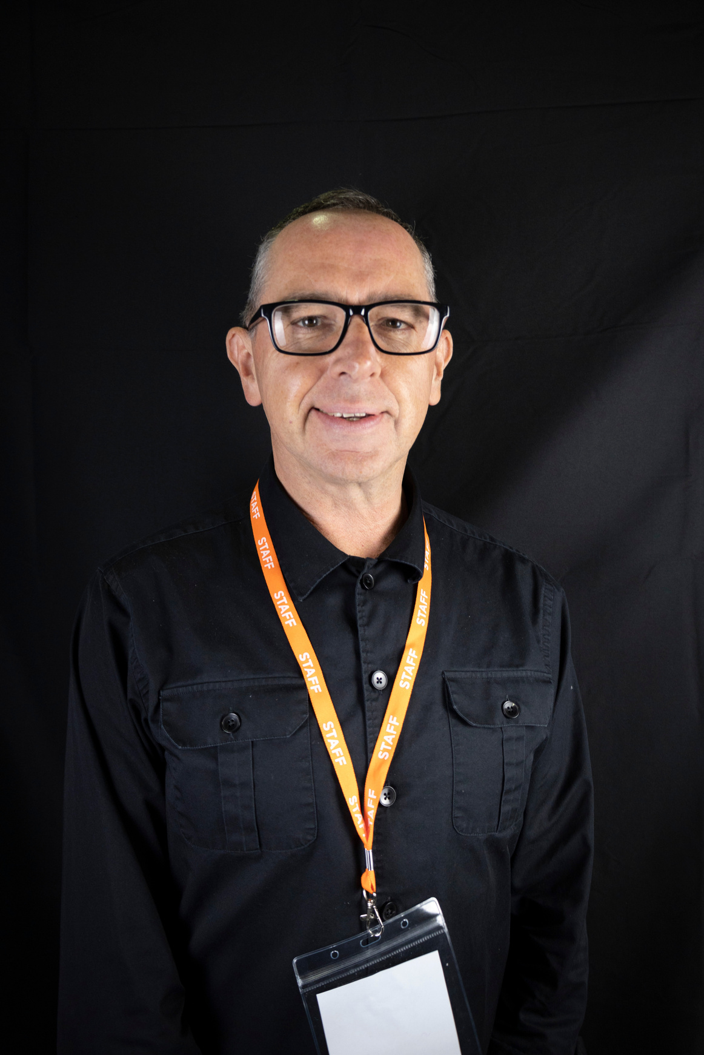
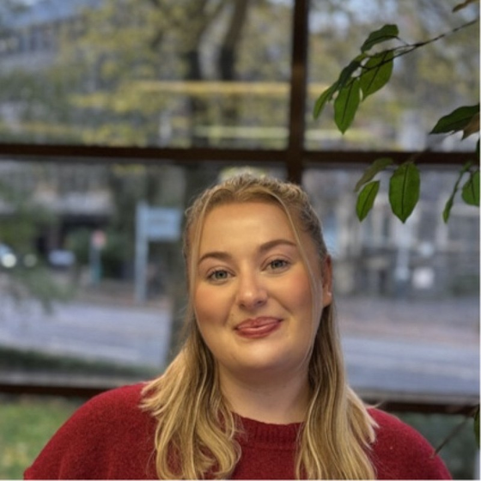

Your hosts:
David Lloyd
Caitlin Brown
Programme Director
Event and Communications Co-Ordinator

Slide 4
THANK YOU TO OUR SPONSOR
DIOLCH I EIN NODDWR

Slide 5

Housekeeping
Session will NOT be recorded
Please complete feedback form
Slides will be emailed out after the session
Ni fydd y sesiwn yn cael eu recordio
Llenwch allan ffurflen adborth
Bydd sleidiau yn cael eu danfon allan

Slide 6
Housekeeping
Closed caption feature is available to use
Os oes angen, gallwch defnyddio CC
Chat function is available to use
Feel free to use Welsh if preferred
Gallwch defnyddio’r chat os oes angen
Diolch...
Defnyddiwch Cymraeg os wyt ti eisiau

Slide 7
Upcoming TPAS Cymru Events
Digwyddiadau TPAS Cymru

Slide 8

Annual Conference

Slide 9

Regulation, Governance & Tenant Voice: exploring the latest key issues

