Slide 1


Slide 2
Things to know:
Please put yourself on mute when not speaking
This session will be recorded and shared after- if not comfortable with this then please turn camera off
Enjoy !

Slide 3

Session order:
Host introductions and welcome
Context
Open floor insights sharing- 5/10 minutes
Speaker session-20 minutes presentation then Q&A

Slide 4
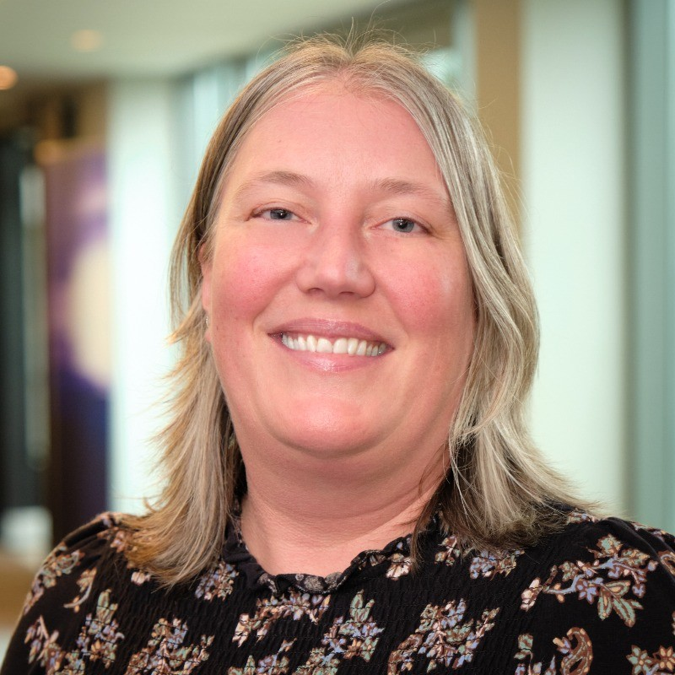
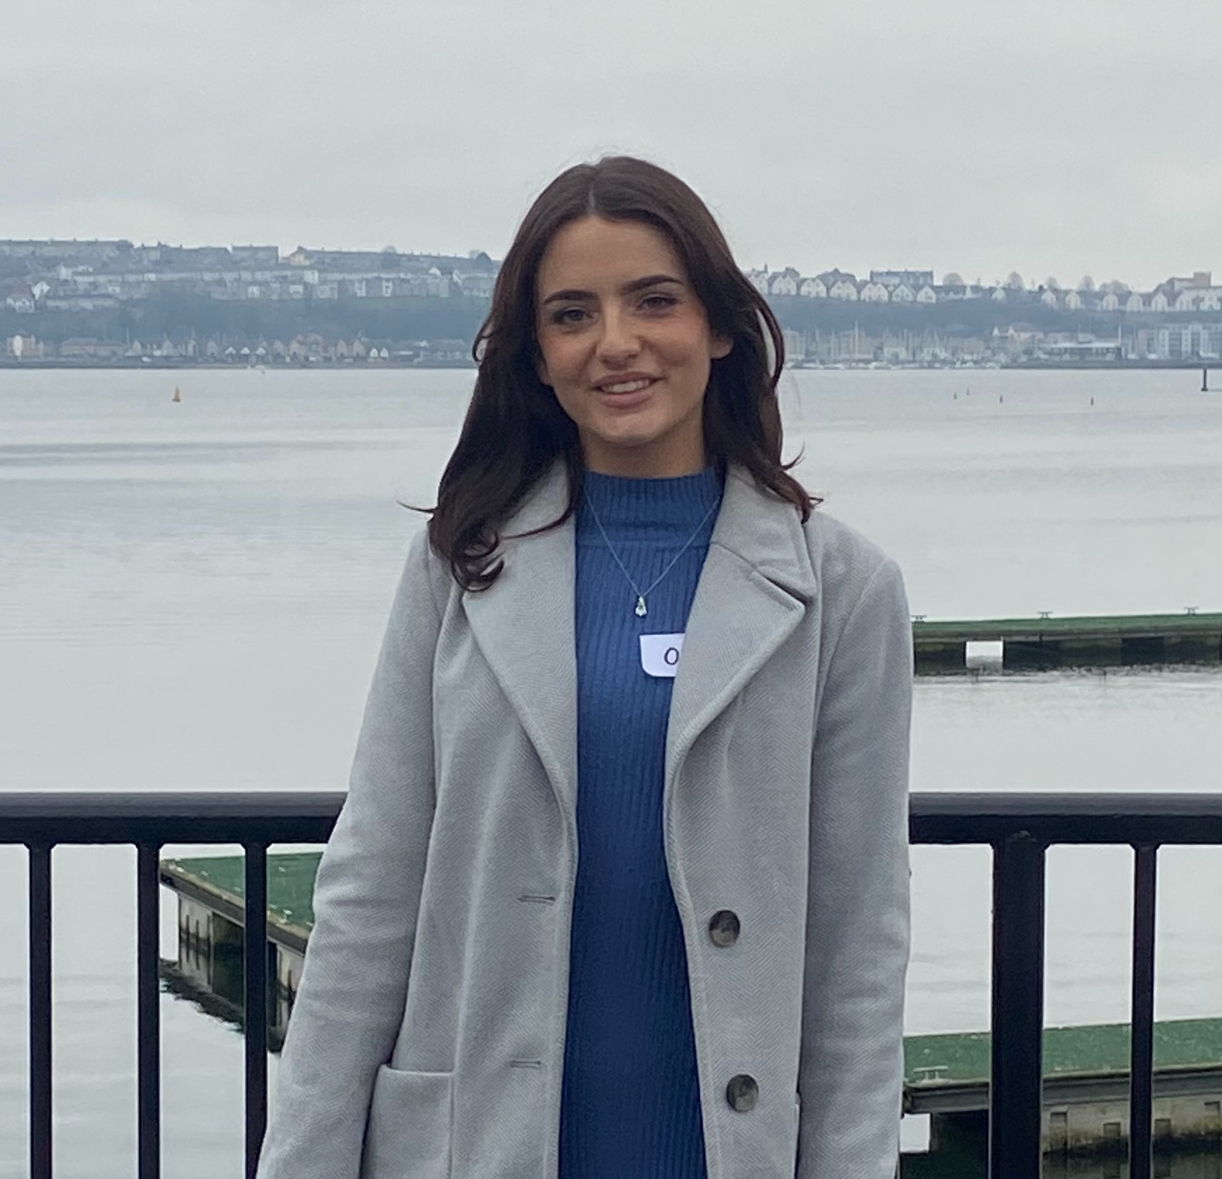


Today's Hosts:
Emma Gilpin, Head of Consultancy
Olivia Browne, Policy and Engagement Officer

Slide 5



3 nations event

Slide 6

Tenants: Where are you from?

Slide 7


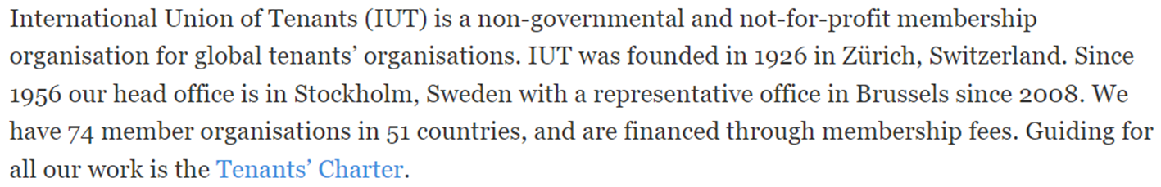
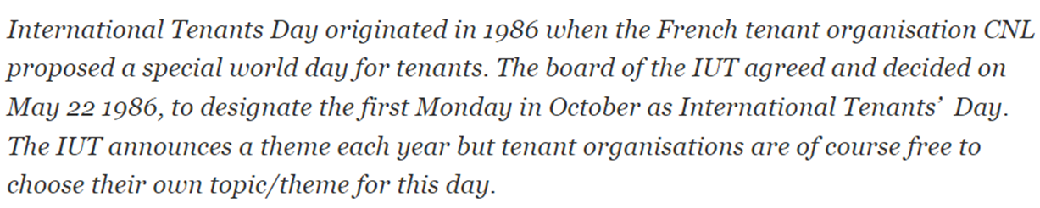

Slide 8
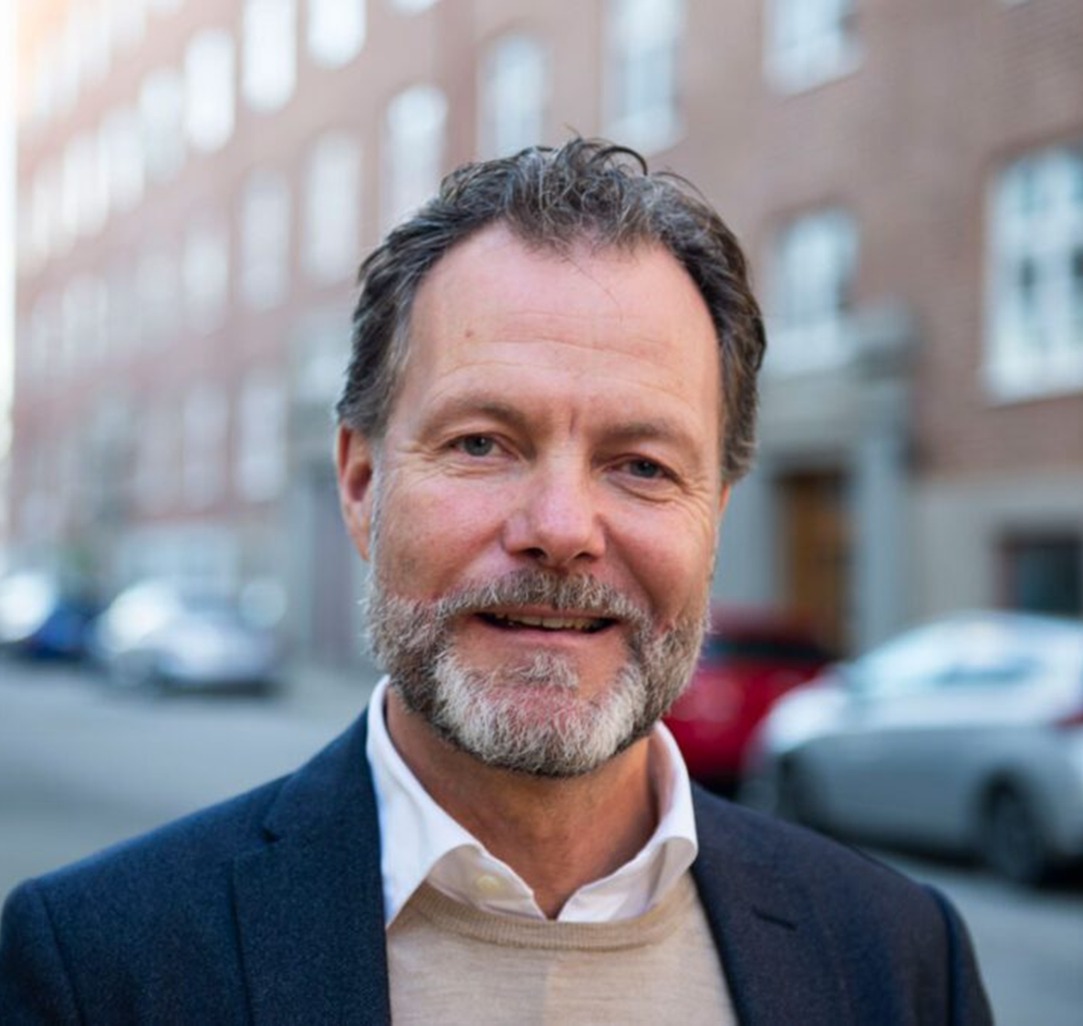
“On International Tenants’ Day, we honour the shared struggle and commitment of tenants around the world. Everyone deserves a safe, secure, and affordable home – and achieving that requires more than national action.
The International Union of Tenants plays a crucial role in bringing tenant organisations together across borders, enabling us to learn from each other, raise our collective voice, and advocate for housing as a human right. This day reminds us that solidarity and cooperation are key to building fairer housing systems – locally, nationally, and globally.”- Dan Nicander, IUT Secretary

Slide 9
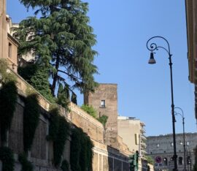
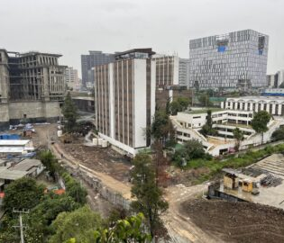
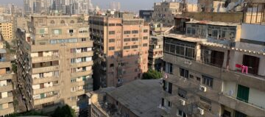
This Year’s Theme: The Urban Crisis Response:

Slide 10
IUT Resolution
Statement from IUT President Marie Linder:
“Having a home is not a privilege – it is a fundamental human right. On International Tenants’ Day, we call on governments to act with urgency: protect tenants, invest in affordable homes, and ensure that cities are built for people, not for profit. Only then can we secure dignity, equality, and justice in housing for all.”

Slide 11
🕐 10-Minute Roundtable: “Urban Crisis, Global Challenge — Let’s Build for People, Not for Profit”-
What does the phrase ‘building for people, not for profit’ mean to you as a tenant or housing advocate?
What do you think is the biggest barrier preventing affordable, secure housing in your city today?
The IUT calls for governments to treat housing as a human right. What’s one concrete action you think local or national leaders could take to make that a reality?

Slide 12


Slide 13

Happy ITD from TPAS Cymru
Video link= https://youtu.be/g6JGKsCGETw

Slide 14
TPAS England: Words of support
Why we were established
Our purpose still.
Value of learning from other countries

Slide 15

Now, please welcome our speakers:

Slide 16
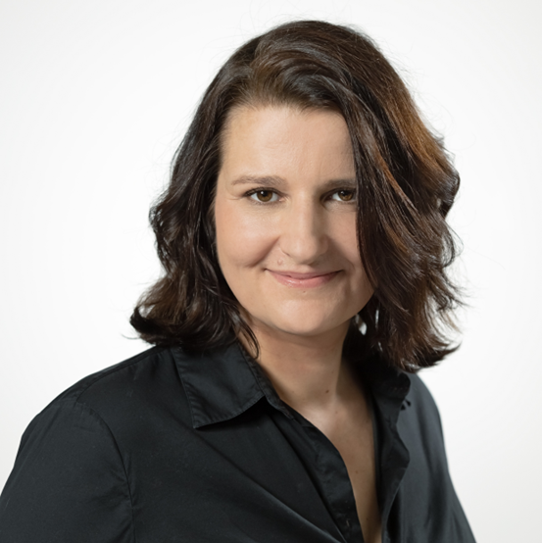
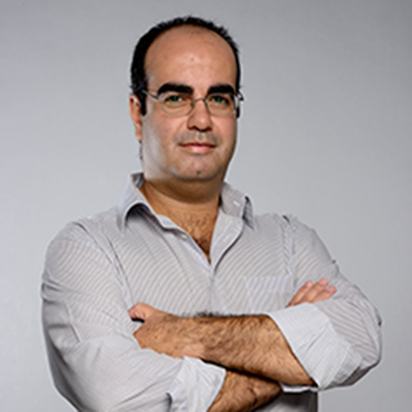
International Tenant Experts:
Marisa Herzog-Perchtold
Senior Housing Expert and a member of the Executive Committee of the Viennese Tenants’ Organization
IUT Board Member
Luís Mendes
Vice‑President of Lisbon Tenants Association
IUT Board Member

