Slide 1
Using Simple Digital Tools to improve Local Communities

Slide 2


David Rhys Wilton
drw@tpas.cymru
@dai_tpascymru
LinkedIn
Notes:
From Dinas Powys
Live in Penarth
Passionate Barry Town supporter

Slide 3
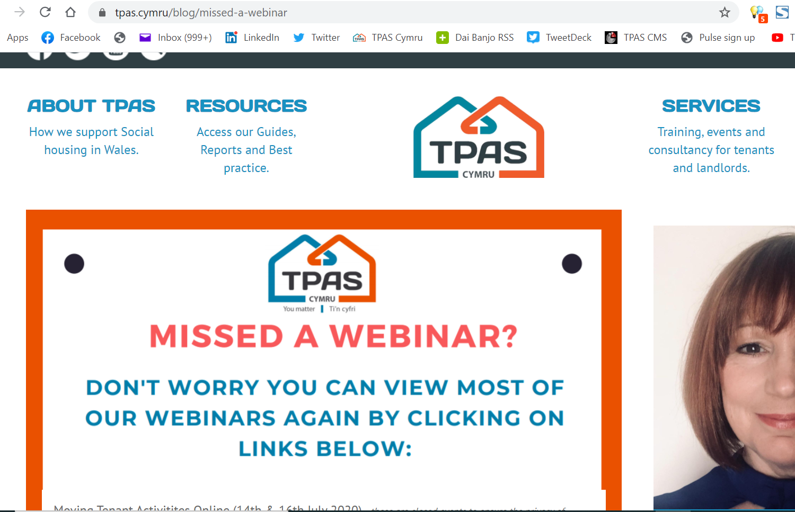
www.tpas.cymru/blog/missed-a-webinar

Slide 4
Digital communications is key to widening engagement
Communication Training
Plain language in Housing
Accessible Communications
Digital Engagement Training
Digital and Community Engagement
Video as a engagement tool
Technology And Engagement
Tomorrow’s World now!
Webinars & Guides - Alexa, Snapchat, Event listings
Introduction to Response Behaviour

Slide 5

Community Improvement
Fixmystreet.com an App & Website for people

Slide 6
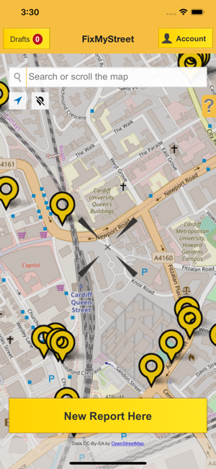
Available from phone and tablet app stores
Less than 60seconds
Confirm location
Optional: Add photo
Select Category
Add title and optional description/note

Slide 7
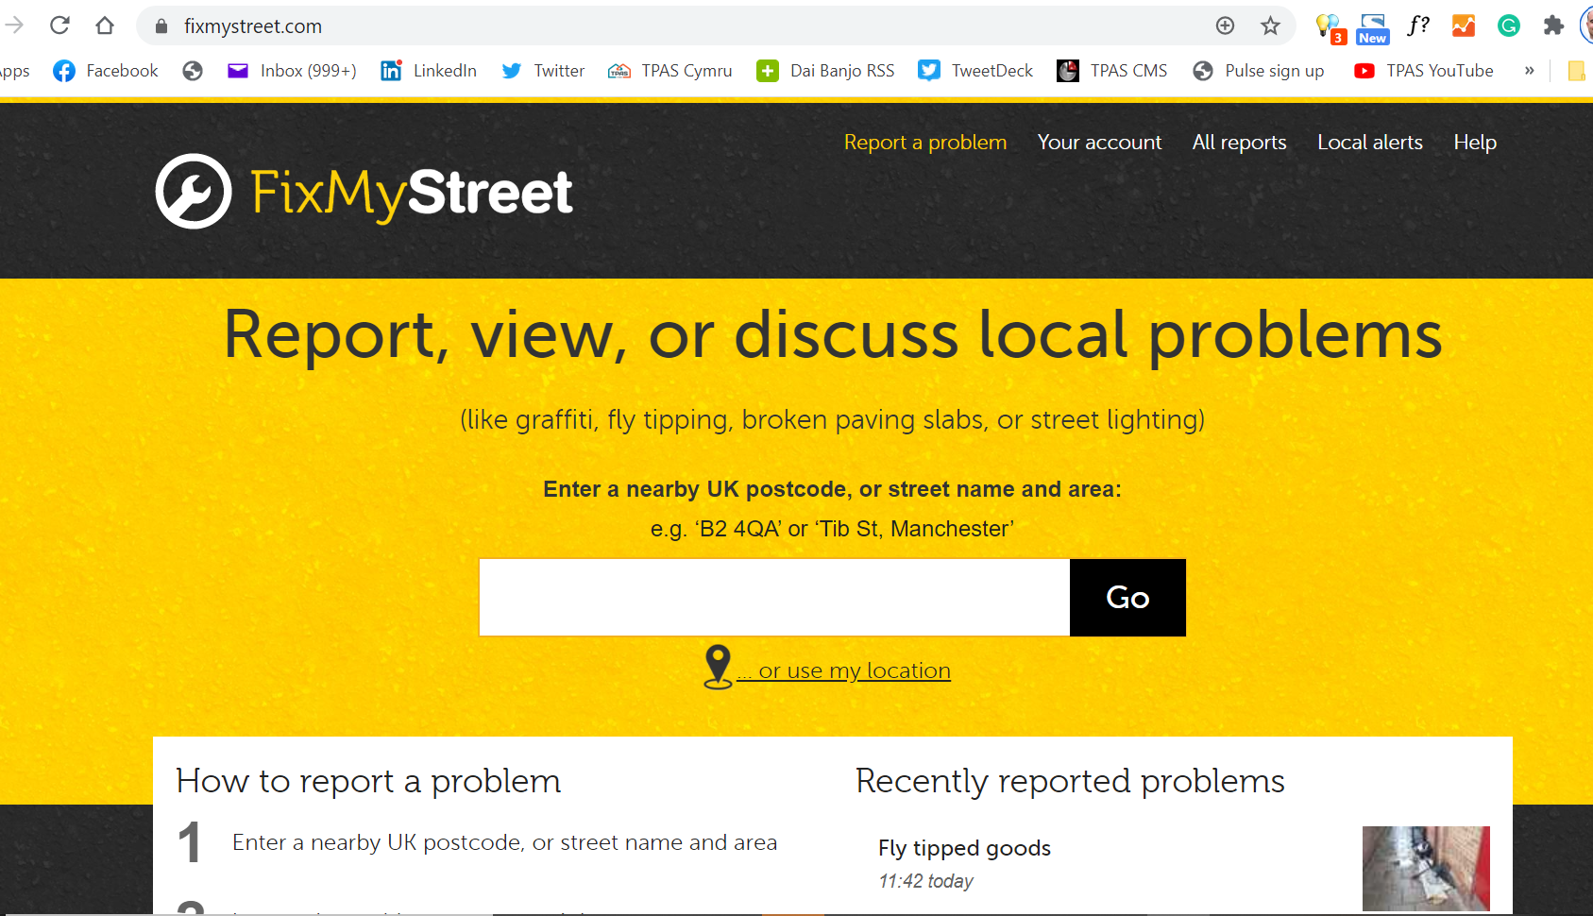

Slide 8
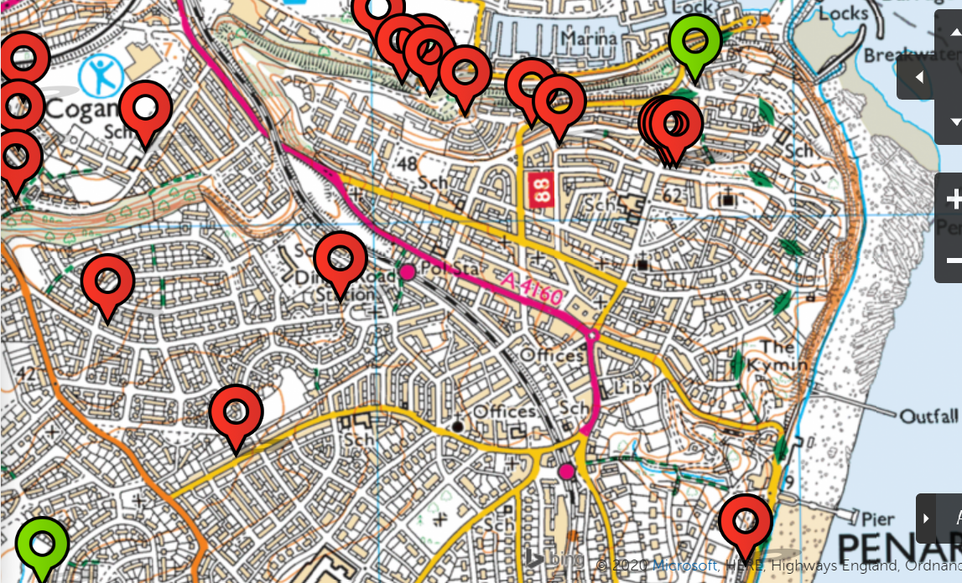

Slide 9
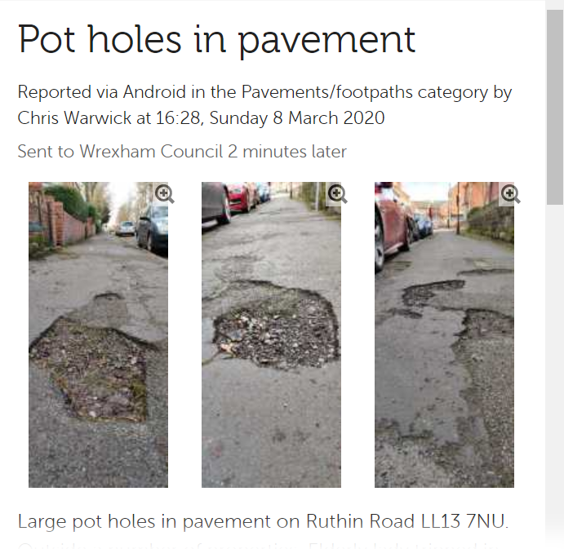

Slide 11
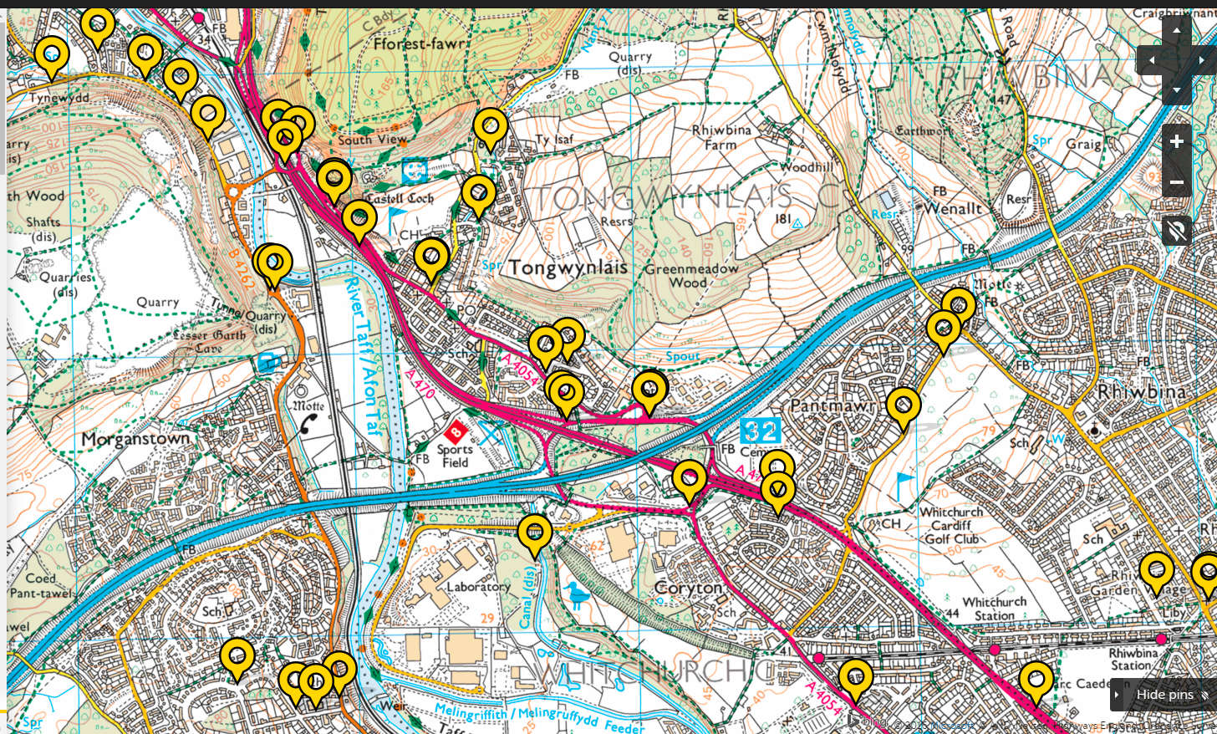

Slide 12
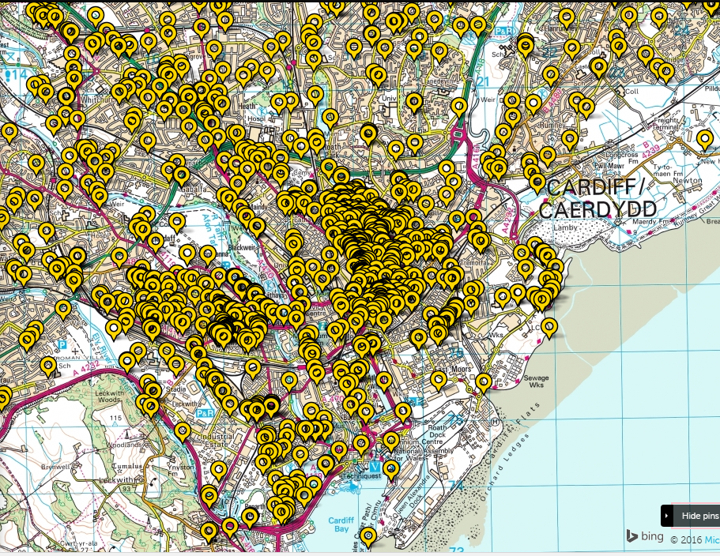

Slide 13
Community help and support

Slide 14



Slide 15
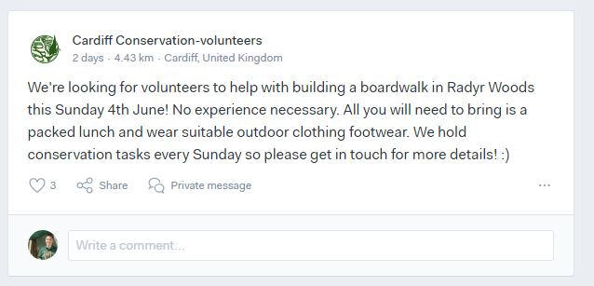
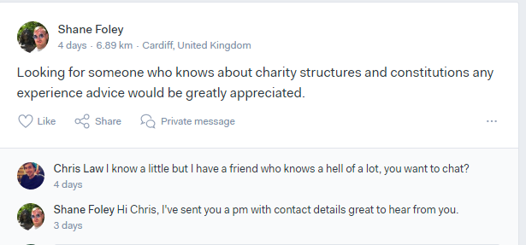

Slide 16
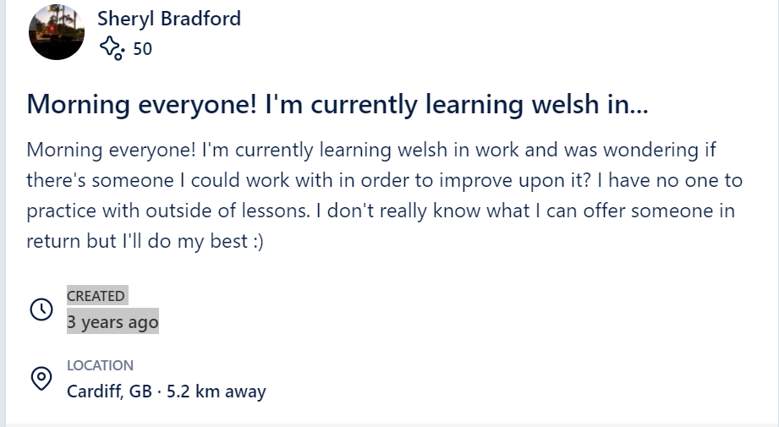
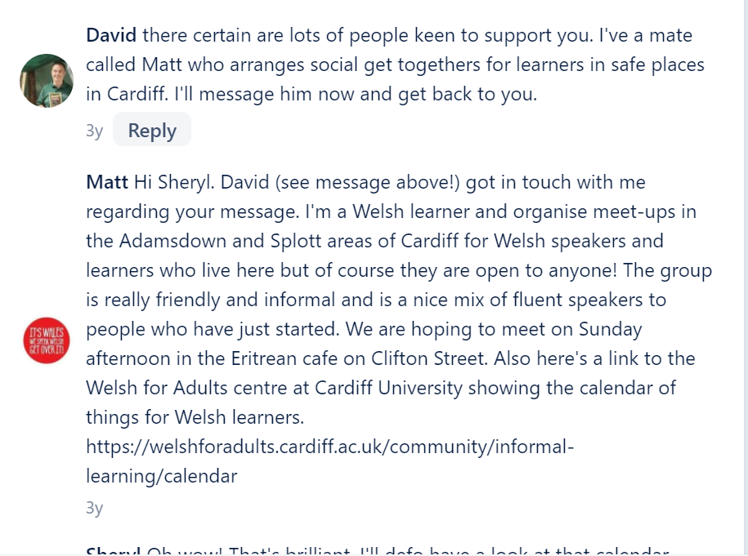

Slide 17
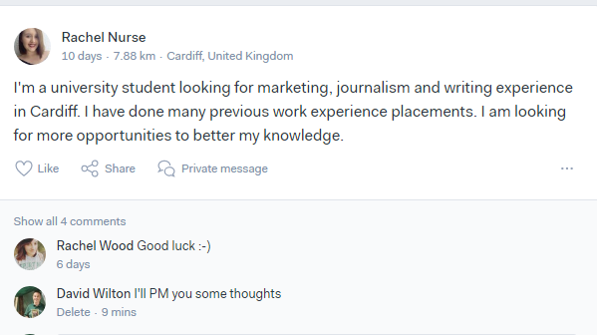

Slide 18
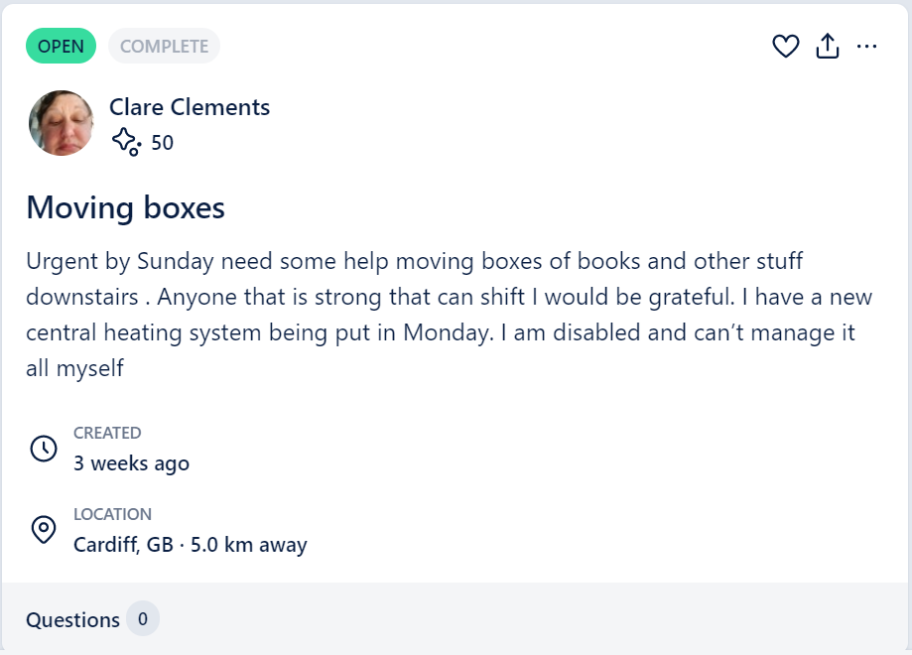

Slide 19
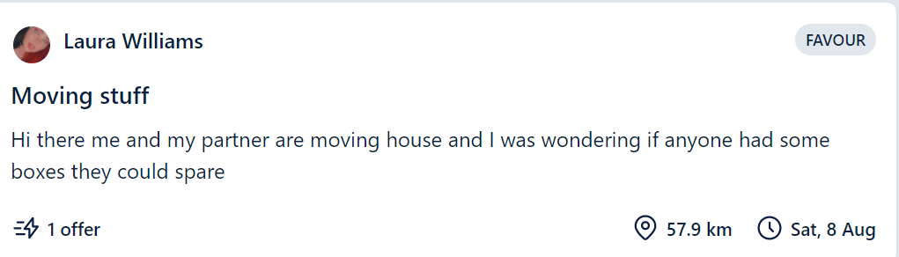
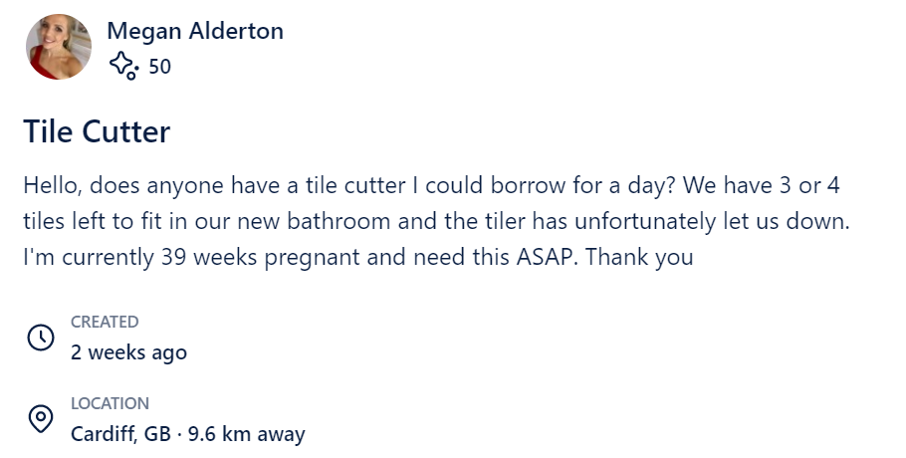

Slide 20
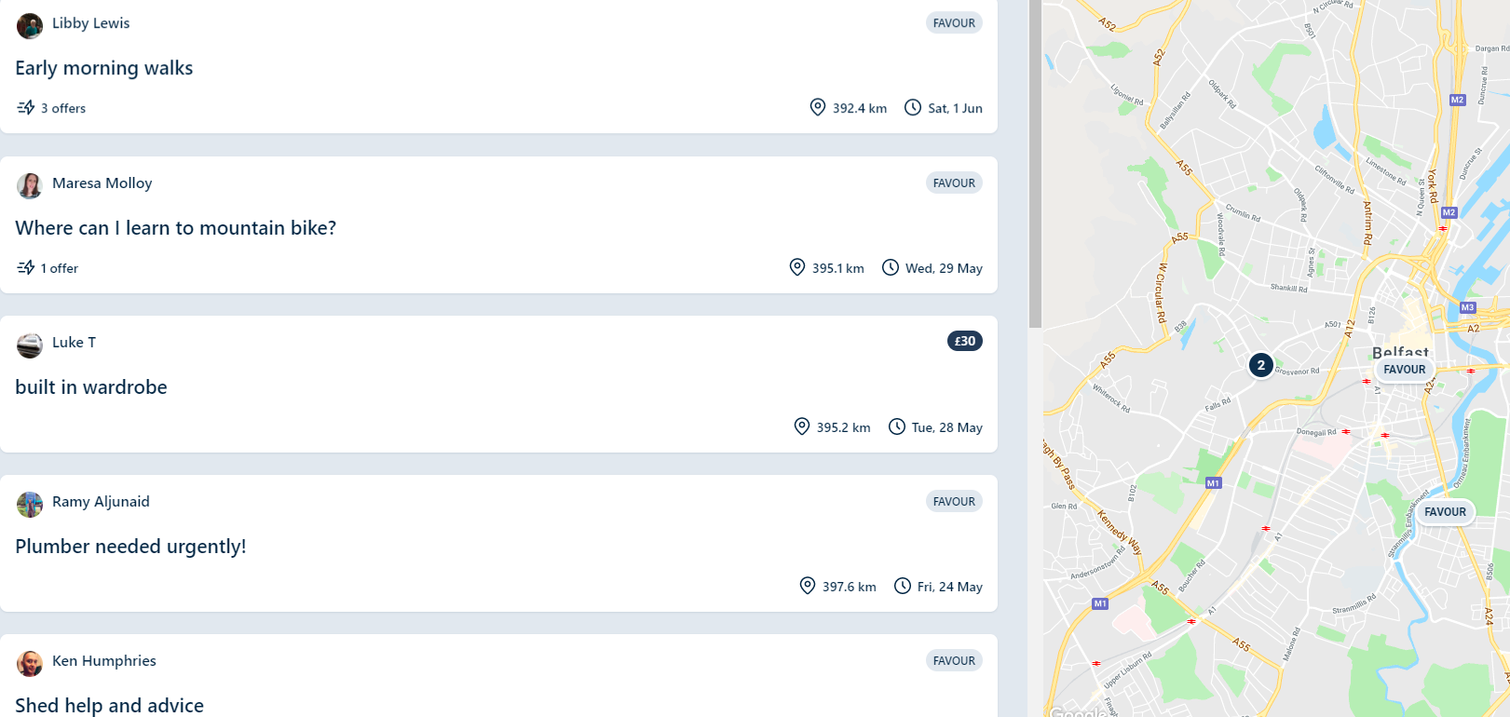
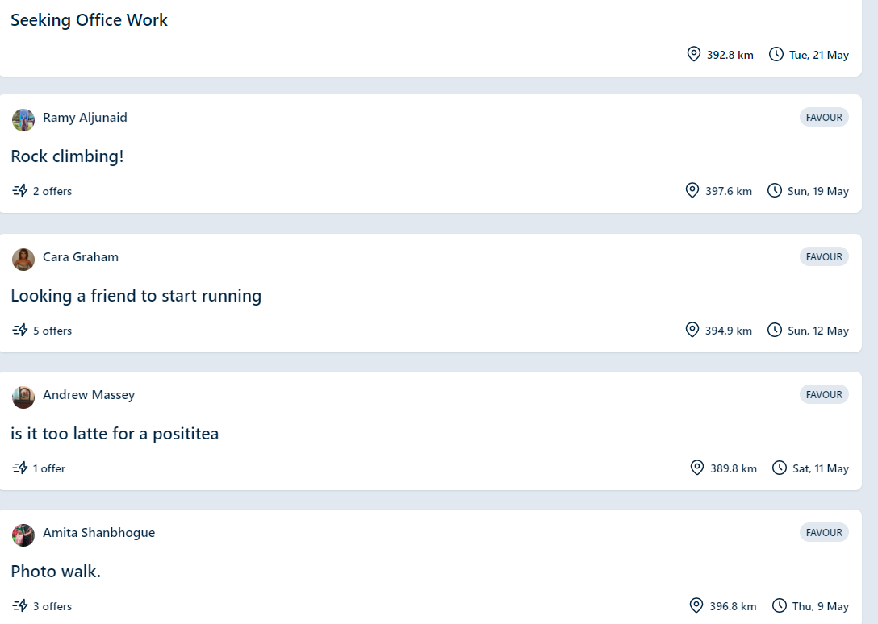

Slide 21


Slide 22
Streetbank
Streetbank is here to help you do three things:
  Give things away – find a grateful neighbour for stuff you no longer need
  Share things – like ladders and drills, that go unused much of the time
  Share skills – like DIY, languages and gardening, that neighbours might need help with
I was looking for lego for my four-year old. A neighbour I didn’t know got in touch and ended up giving me three huge bucketfuls!
We had so much we ended up passing on half of it to my son’s school. I love that – spreading things around your community to where it’s going to be best used.’

Slide 23
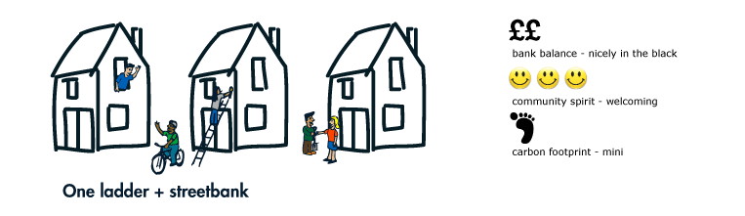
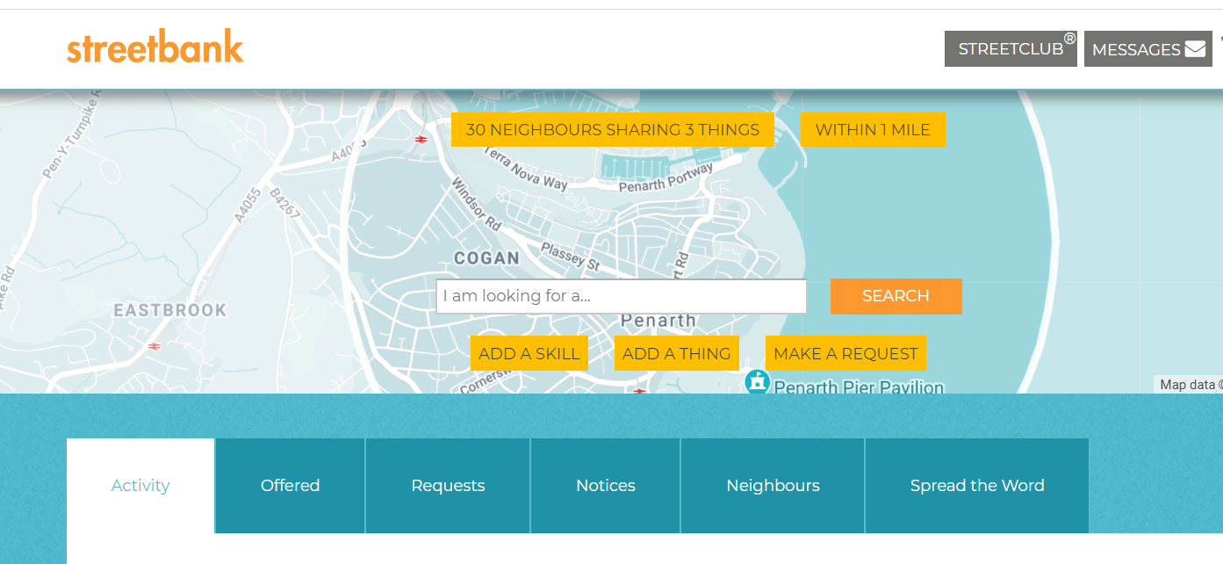

Slide 24

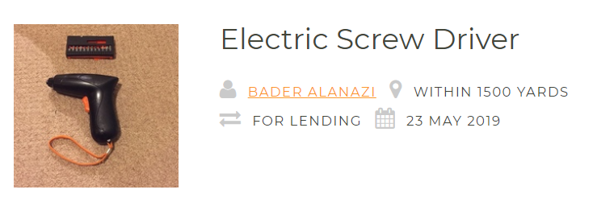

Slide 25
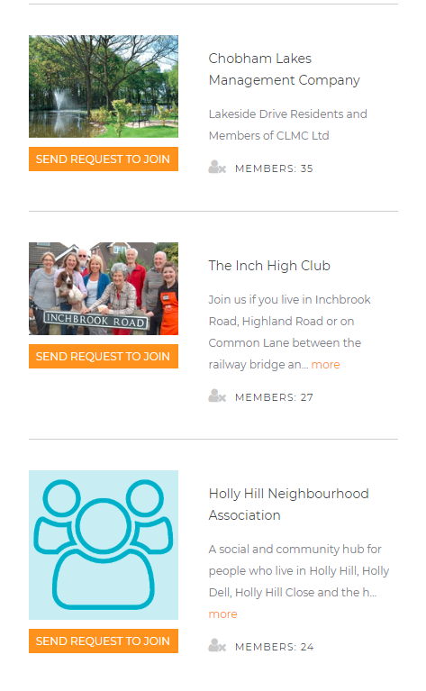
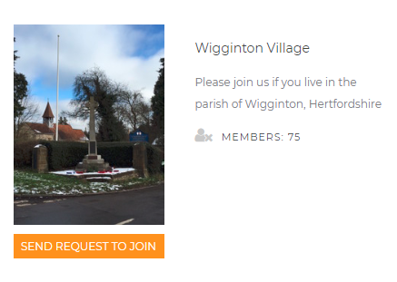
Now you can have sharing clubs based on common communities

Slide 26

The new hybrid world

Slide 27
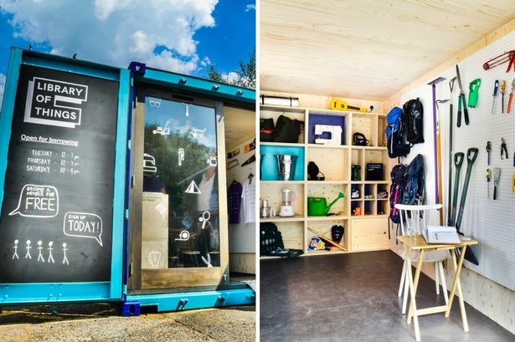

Slide 28
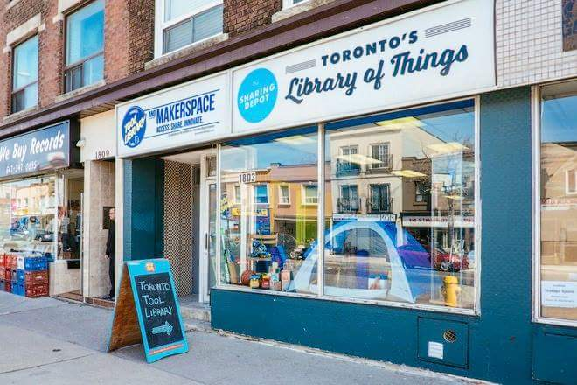

Slide 29
Links to content
https://www.benthyg.org/
That is the Library of Things in Cardiff
www.libraryofthings.co.uk one of the most established ones in London
https://www.youtube.com/watch?v=wuUAg04KZYI
BBC video I played

Slide 30

NextDoor.co.uk
Massive in USA, used in 15 counties.
Signup requires a code via post
Very active in my local area

Slide 31
What people say:
Nextdoor is a useful community site particularly for sharing local information and finding local trades people
Social media for old people !
This is a very good app with which to keep up with happenings in our area
A very helpful site in accessing local resources by recommendation, and for informing others of any safety or anti-social behaviour issues within the community
Great for finding out about local events

Slide 32
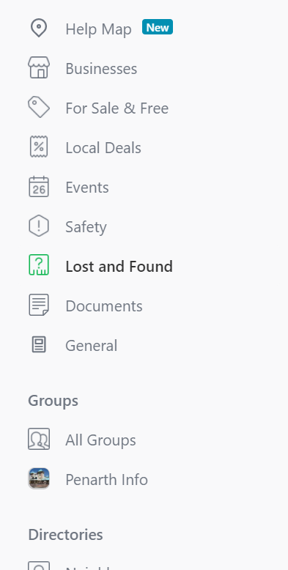
Categories

Slide 33
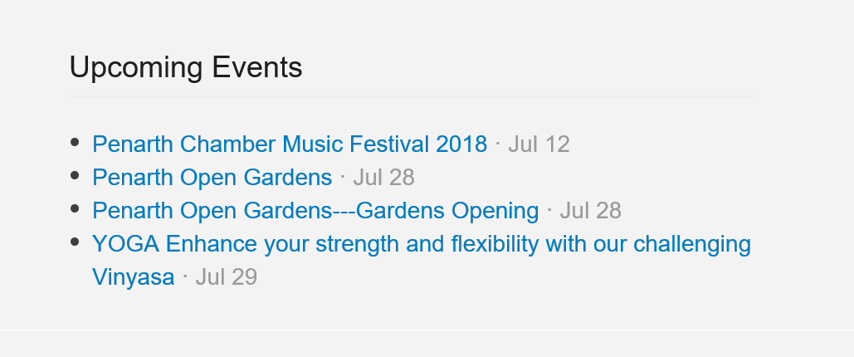
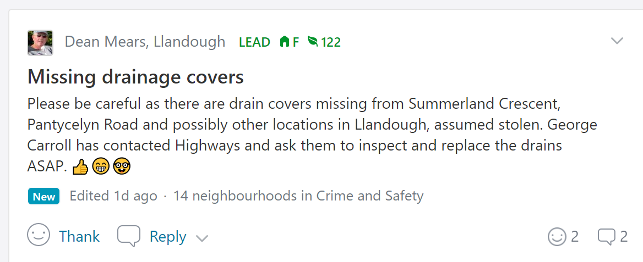
Local news and events

Slide 34
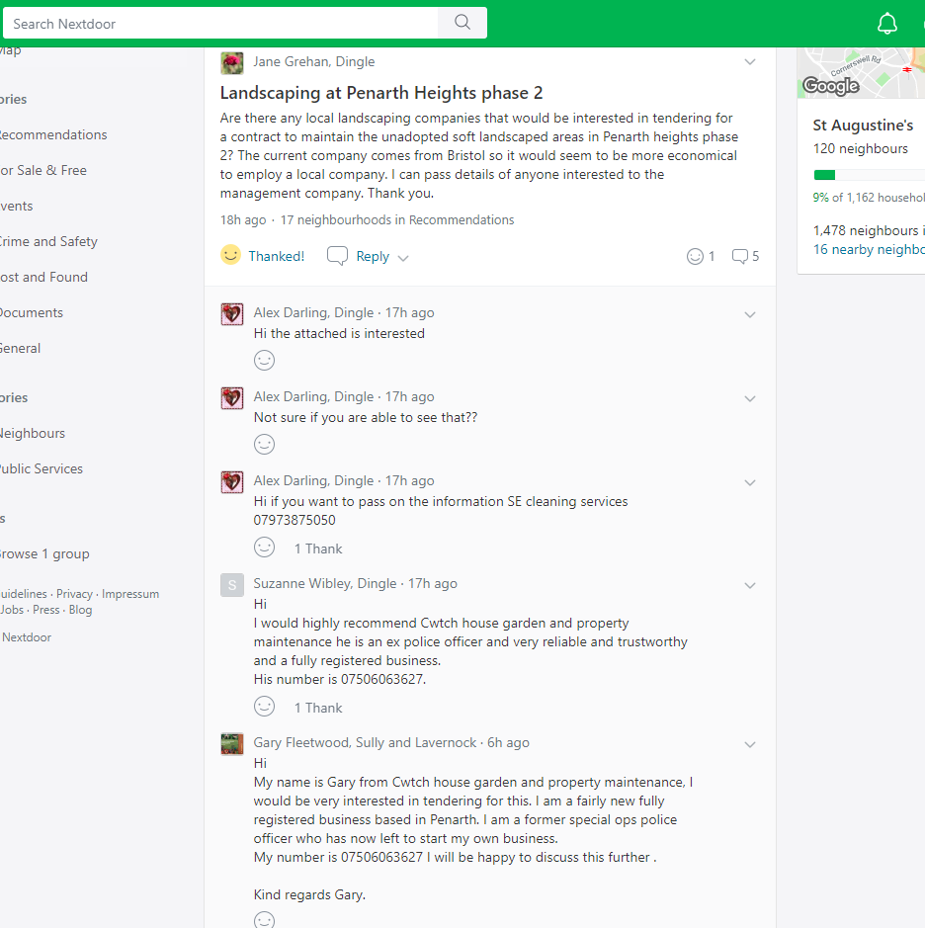
Giving local business a chance
Management company for a new development

Slide 35
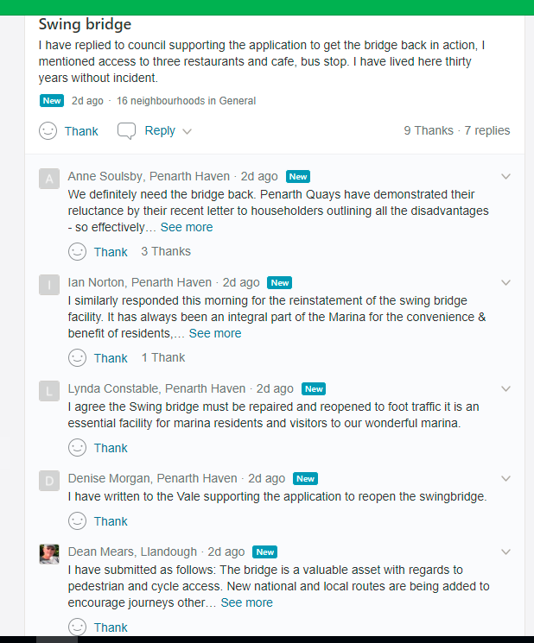
NextDoor.co.uk
Good platform for engagement with local communities with an older demographic.

Slide 36
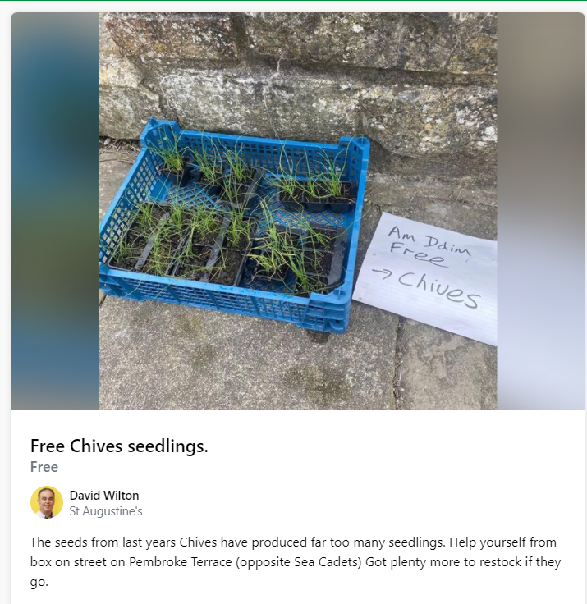

Slide 37
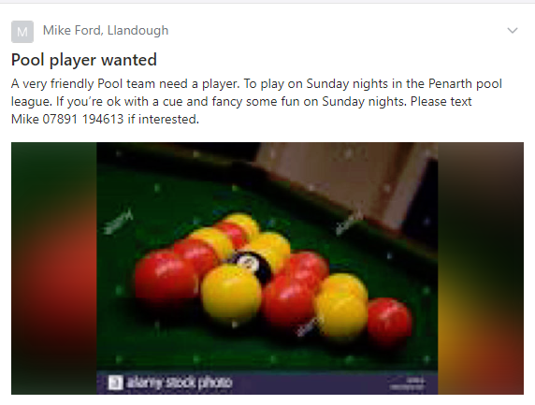
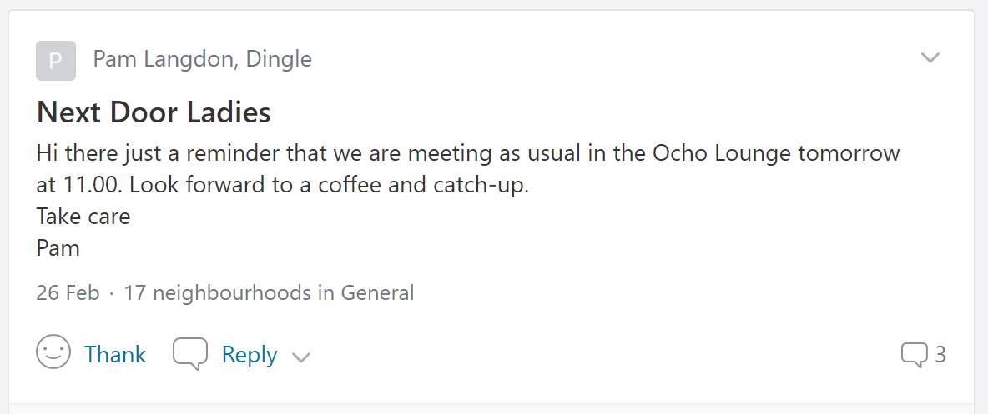

Slide 38
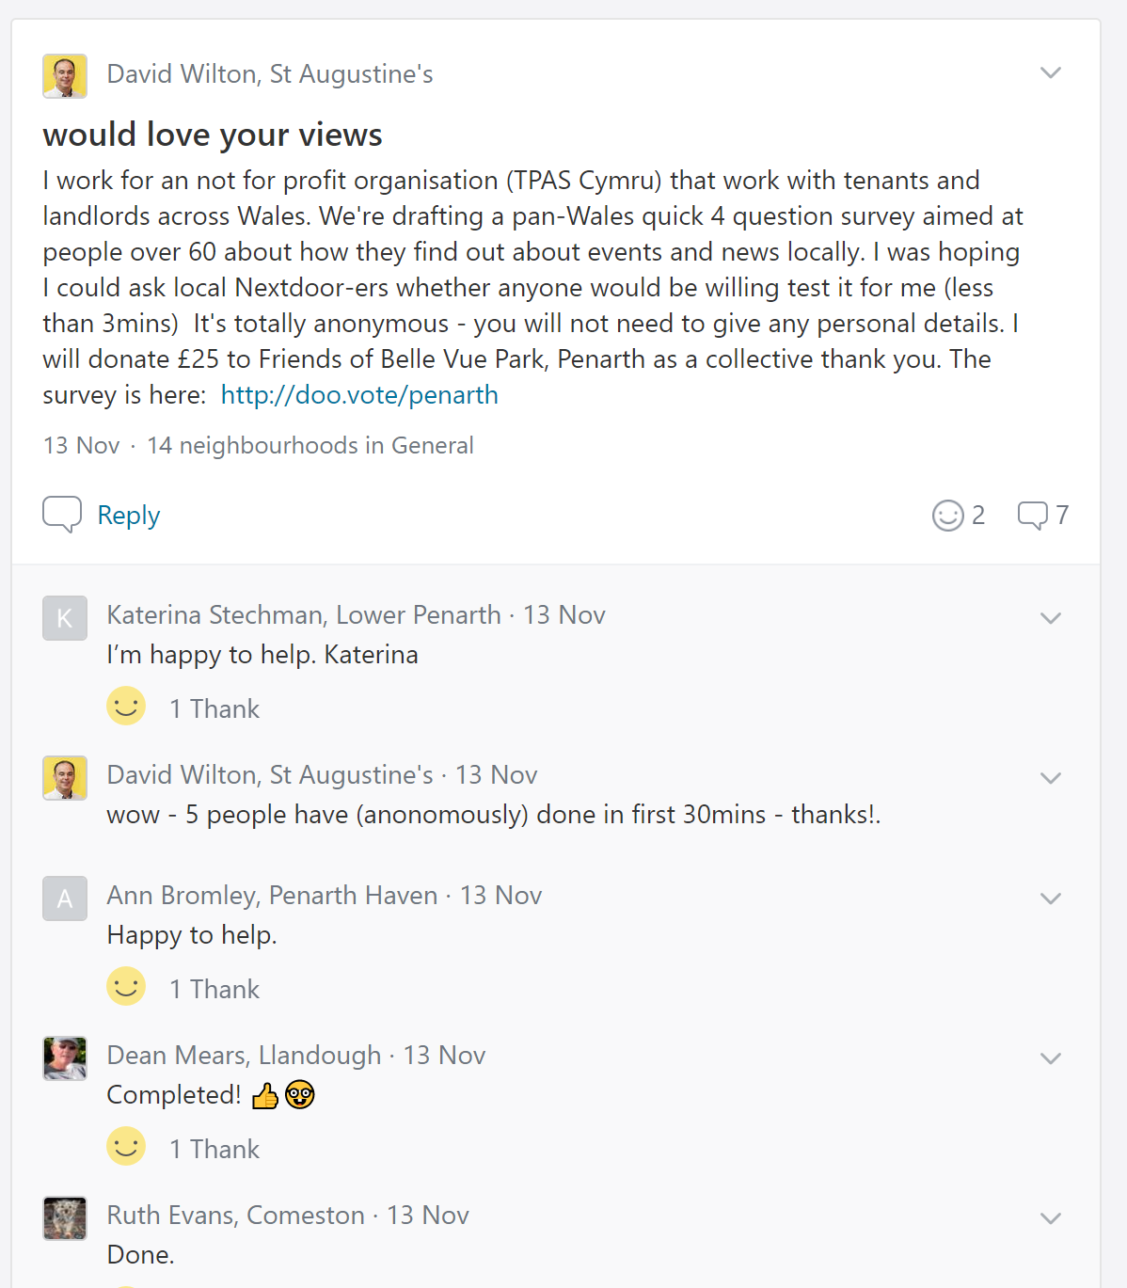
Getting local views
33 responses from over60s in 48hours
Time to make poll = 10mins
Time to post = 10mins
Show appreciation during period <1min

Slide 39
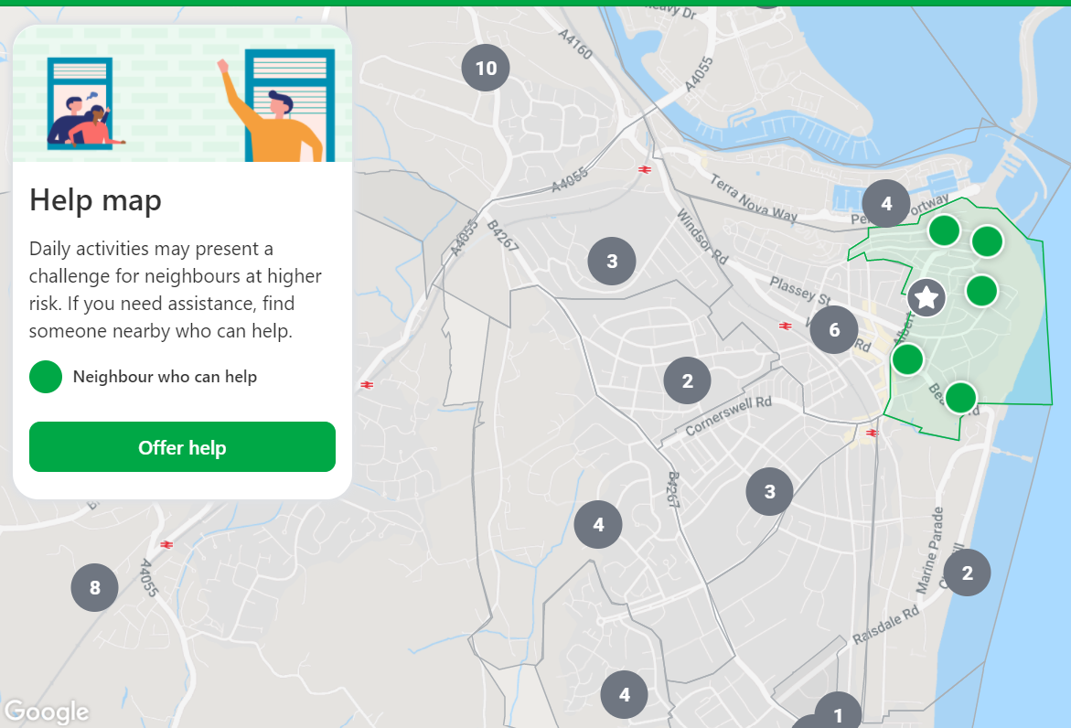
New: Help map

Slide 40

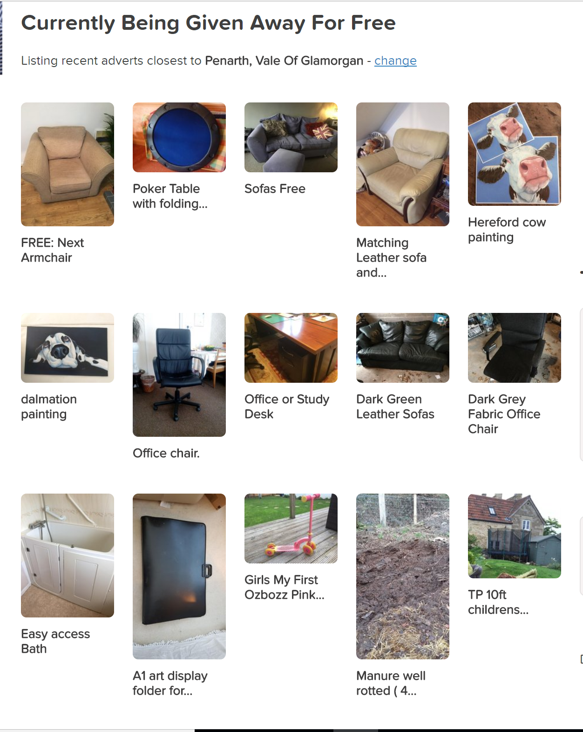
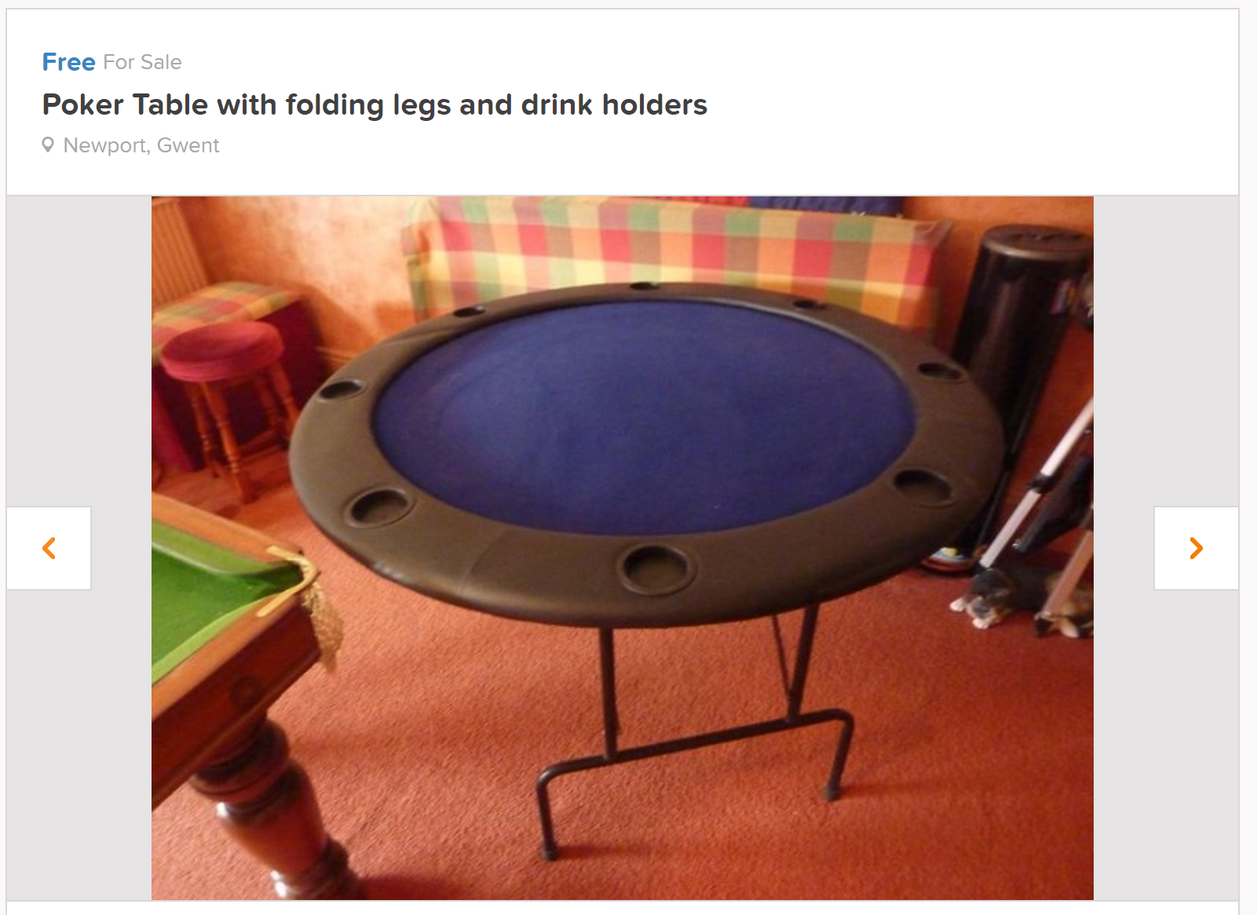
Freelove and classified sales section

Slide 41
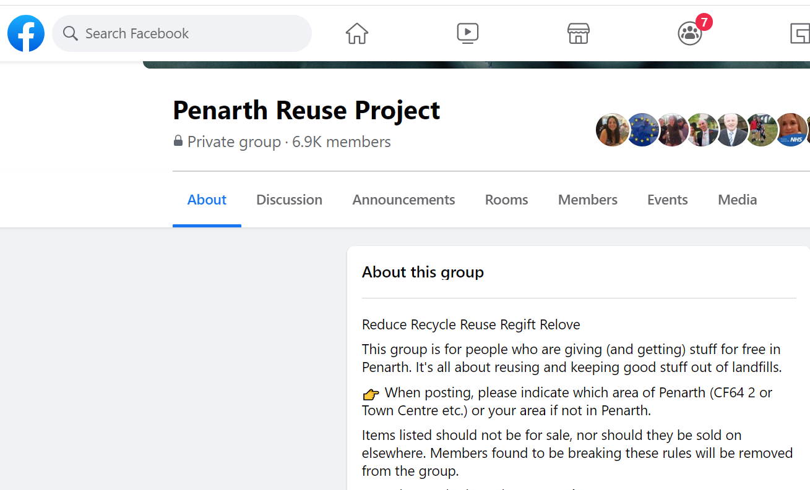

Slide 42
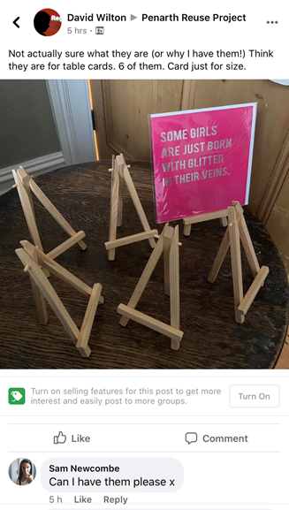

Slide 43
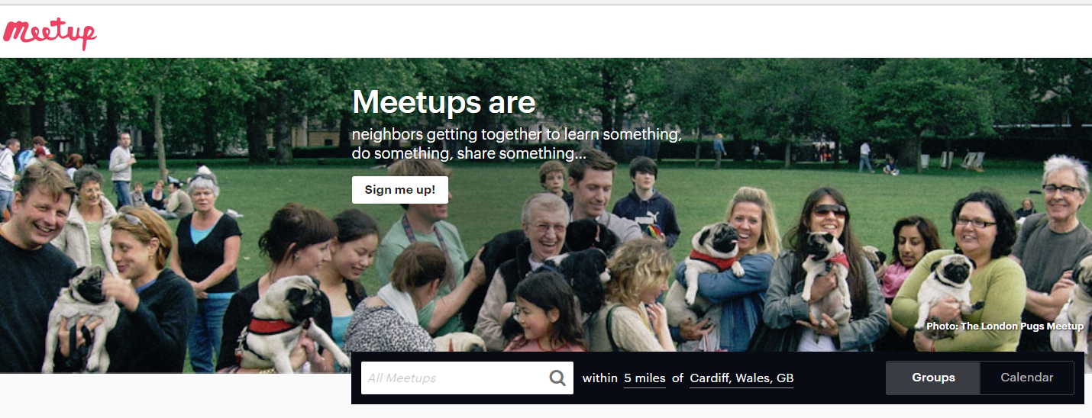

Slide 44
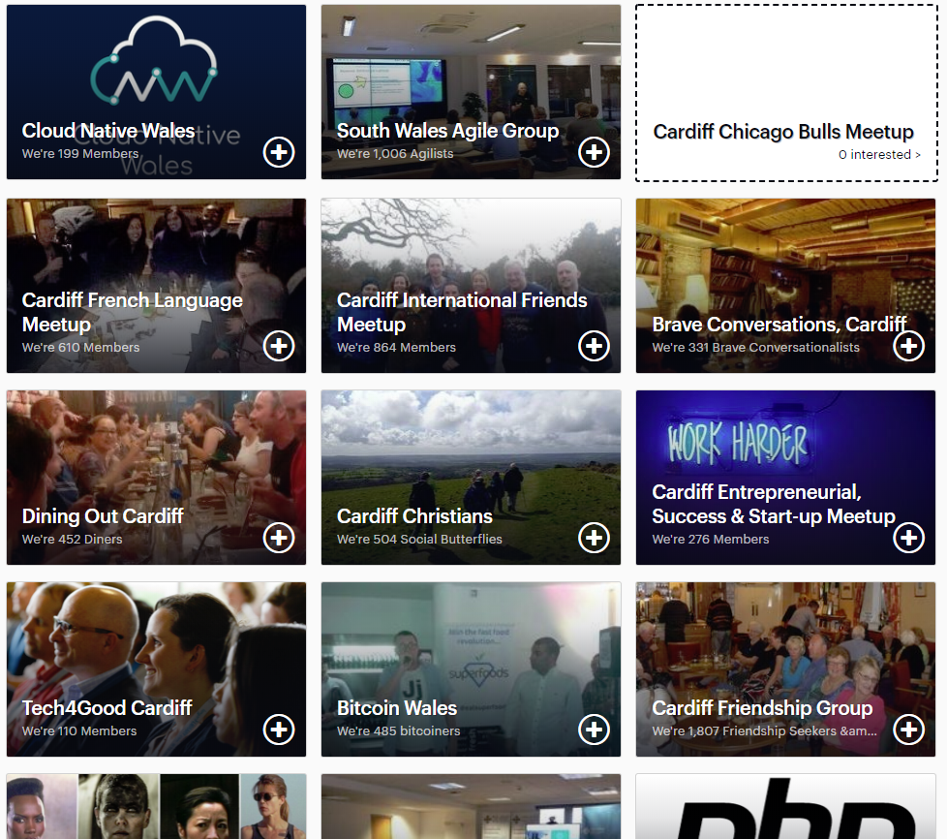

Slide 45
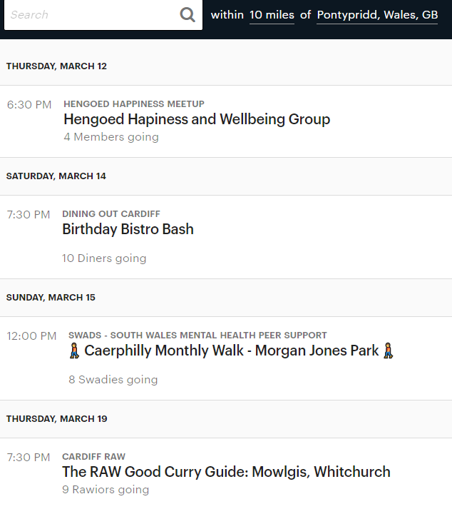
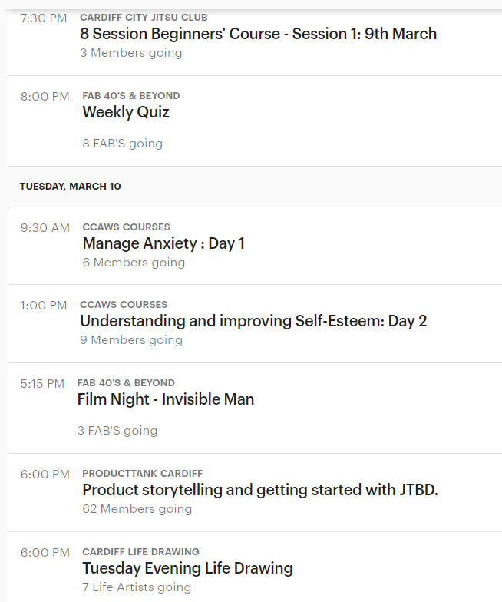

Slide 46
Other community sites
http://www.streetsalive.org.uk
Resources on holding street events, parties etc.

